Slide 1
Caffinated Cock Roaches
By
Alexander Cannell

Slide 2
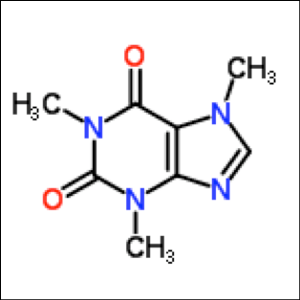
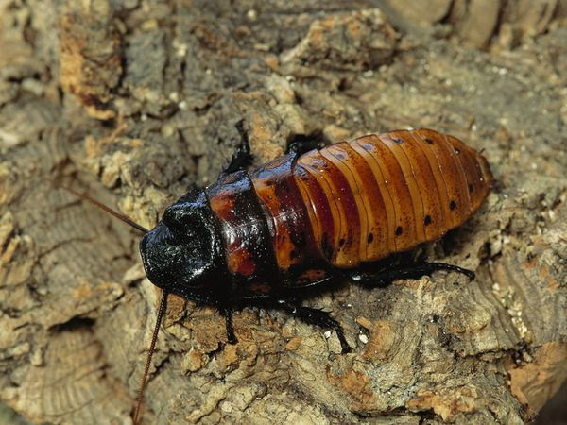
What I Did I Do?
+
Caffeine
Madagascar Hissing Cock Roach

Slide 3
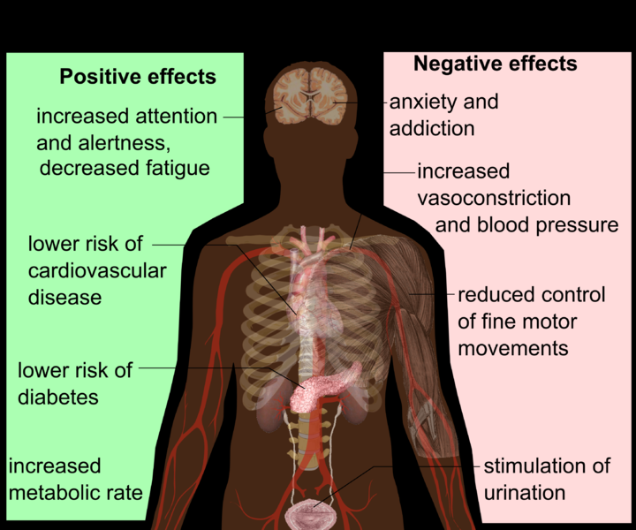
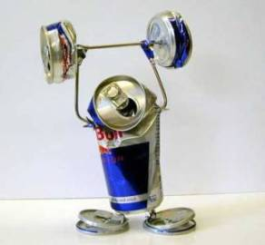
Why I did I selected Caffeinated cockroaches as a project

Slide 4
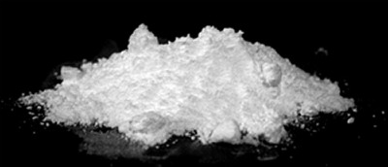
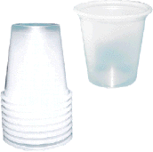
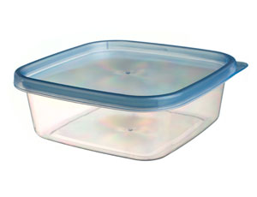
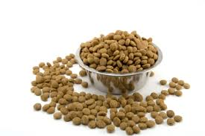
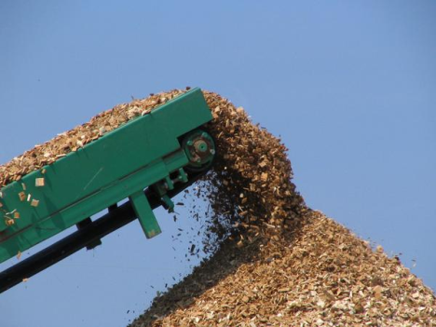
How I set the experiment up
Caffeine
Twelve Cock Roaches
Mouthwash Cups
Twelve Tupperware Containers
Dog Food
Wood Chips

Slide 5
Results
Graph one: Shows the standard deviation for the control cock roaches is 0.370282 and for the caffeinated is 1.13927.
Graph Two: Shows the week by week weight of the cock roaches. The P-Value is 0.7938.

Slide 6
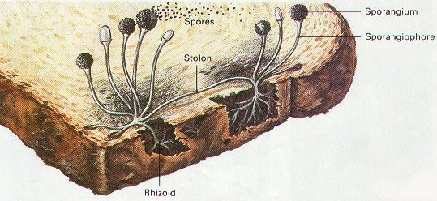
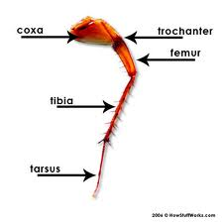
Additional Information/Fun Facts
-

Slide 7

Any Questions?

